Slide 1
MARKETING ANALYTICS I
SESSION 19
SEARCH MARKETING
Texas MSBA Program
Professor Sonnier
Fall 2022

Slide 2
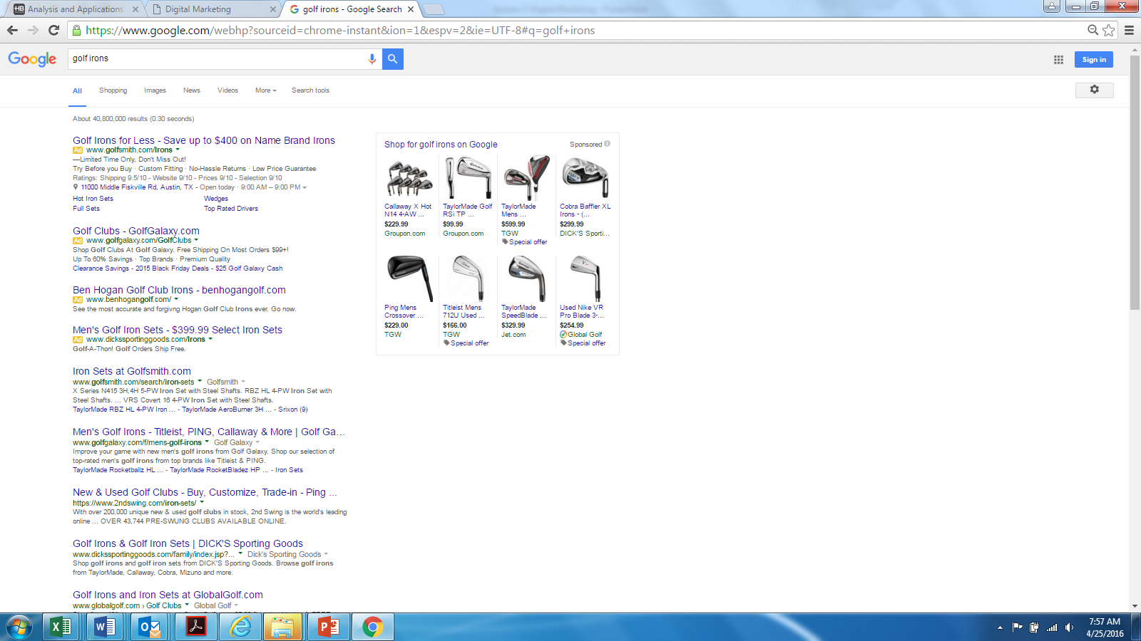
DIGITAL MARKETING
Search Advertising
Paid
Links
Organic
Links

Slide 3
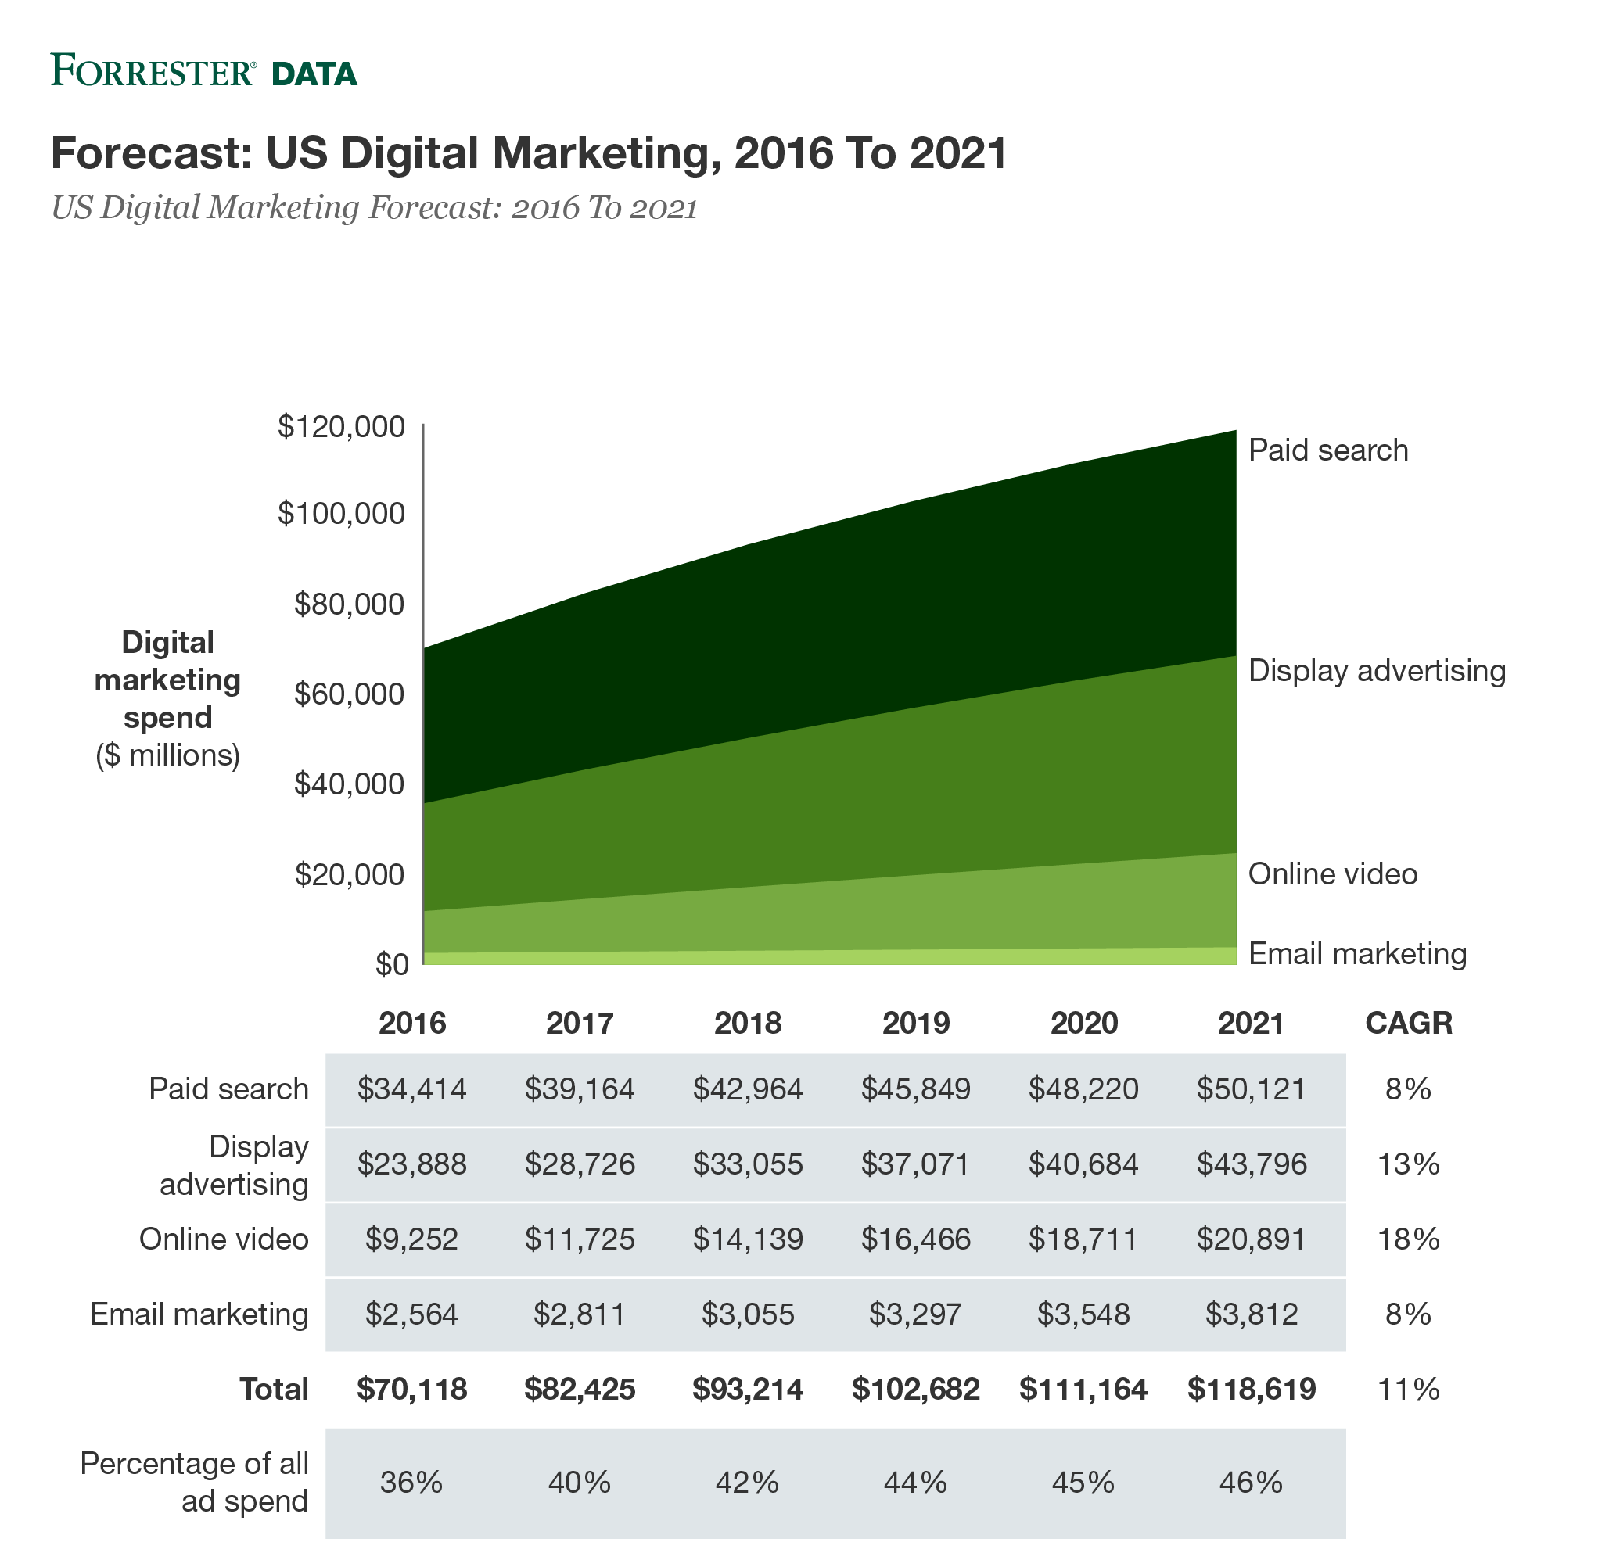
DIGITAL MARKETING
US Digital Marketing Spending, 2016 - 2021

Slide 4
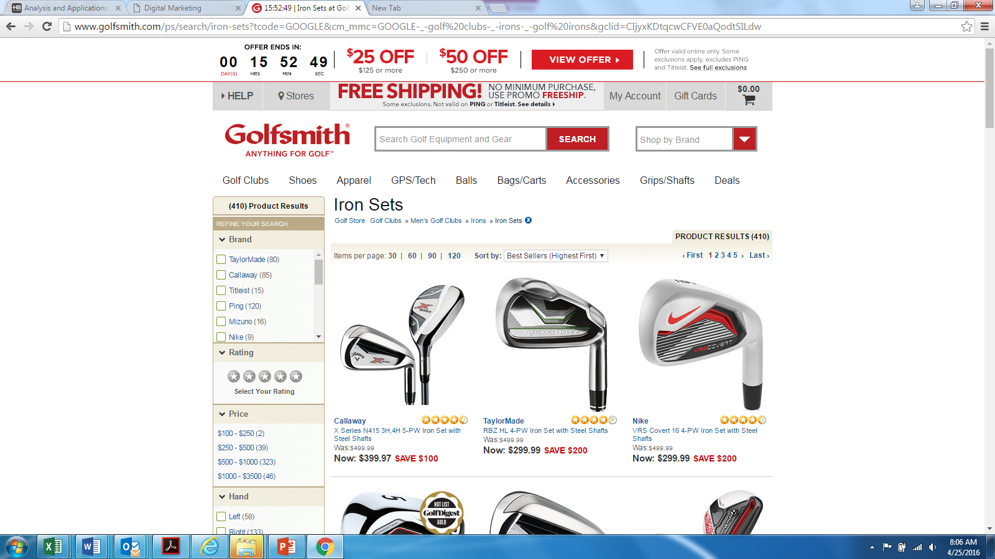
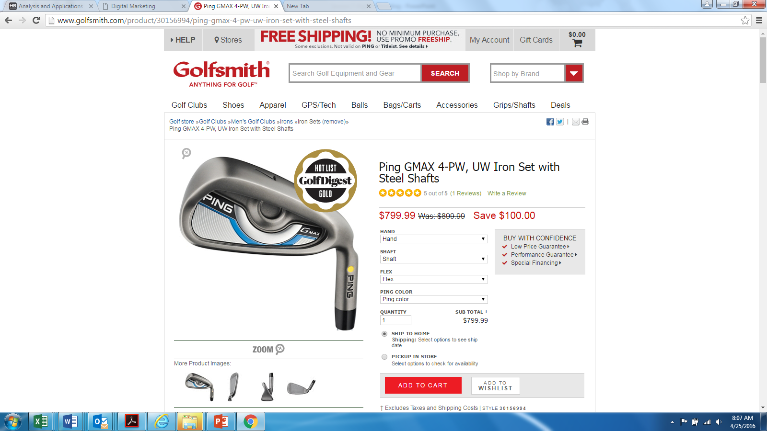
DIGITAL MARKETING
Search Advertising
Consumer’s Perspective
Company’s Perspective
Keyword
Impression
Click
Conversion
Notes:
Porter's five forces model and S-C-P used to work very well for industries in which structure and conduct were best explained by traditional microeconomic approaches.
But during the 1980s and 1990s new forms of industry structure and conduct as well as new bases of competition emerged or were recognized. To effectively cope with that, McKinsey undertook a big research effort (Strategic Theory Initiative, STI) and developed a new and comprehensive approach to deal with new forms of cooperation and competition, new sources of competitive advantages, and to incorporate the increasing uncertainty. In the context of this functional training day we omit discussion of the different levels of uncertainty which actually are an integral part of the STI approach. The key for handling higher levels of uncertainty is to eliminate mere unfamiliarity in the first place and reduce the remaining uncertainty by focusing on its key drivers and projecting distinct plausible scenarios. For the time being just keep in mind this hidden layer of complexity.

Slide 5
DIGITAL MARKETING
Search Advertising: Consumer
SEARCH AND CLICK DECISION

Slide 6
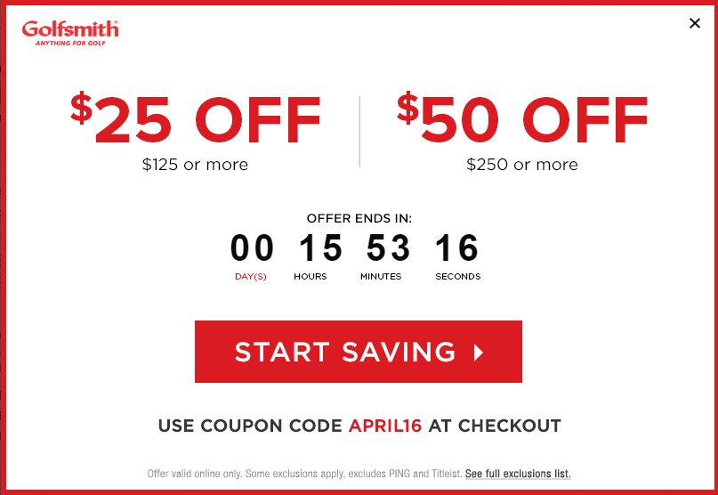
DIGITAL MARKETING
Search Advertising: Consumer
CONVERSION DECISION

Slide 7
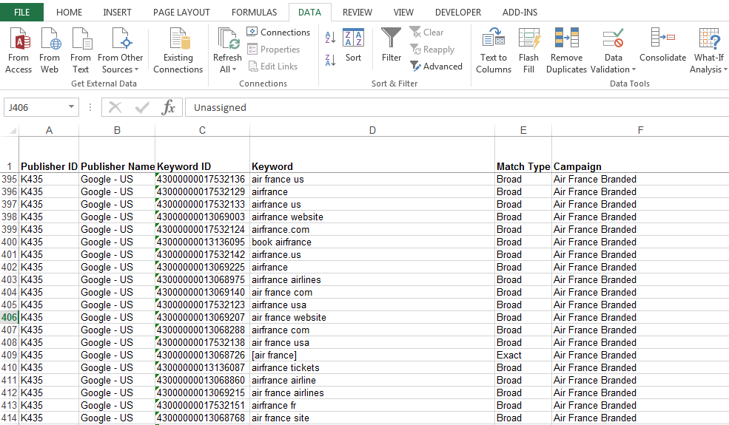
DIGITAL MARKETING
Search Advertising: Advertiser
Buying Keywords
Branded Keywords

Slide 8
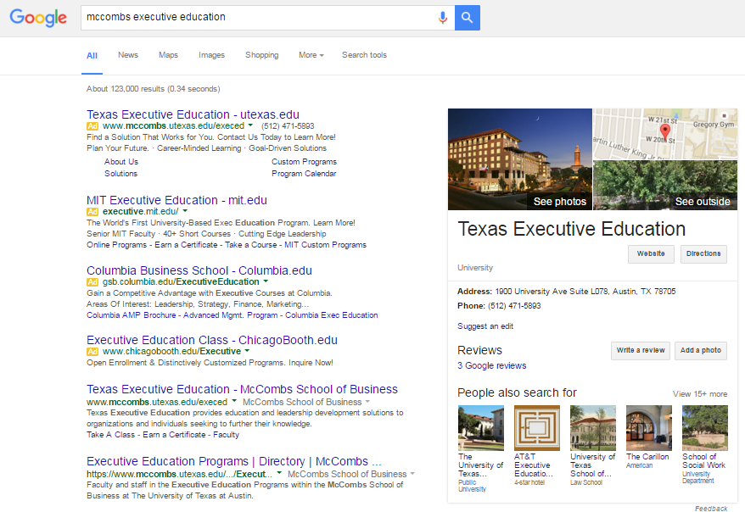
DIGITAL MARKETING
Search Advertising: Advertiser
Buying Branded Keywords
Defend against competitor taking top paid position
Improve click rates on organic links

Slide 9
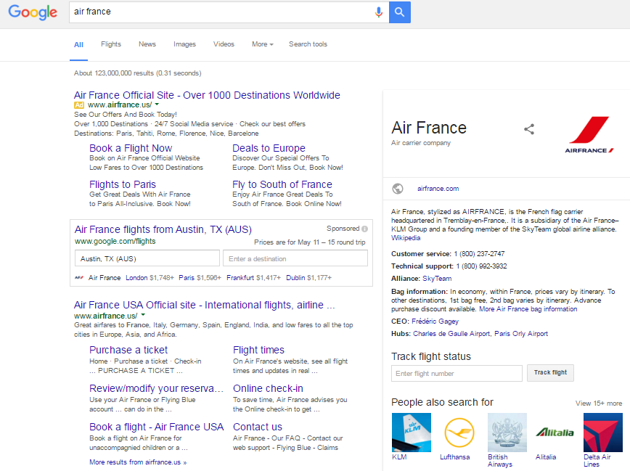
DIGITAL MARKETING
Search Advertising: Advertiser

Slide 10
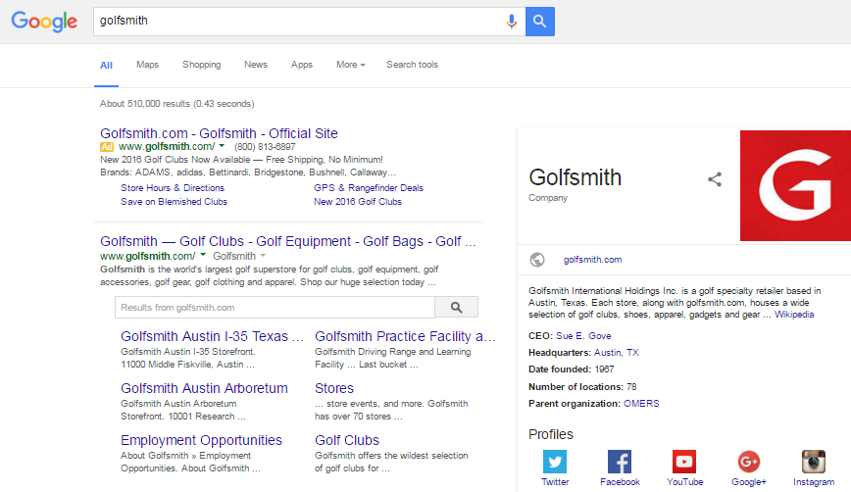
DIGITAL MARKETING
Search Advertising: Advertiser

Slide 11
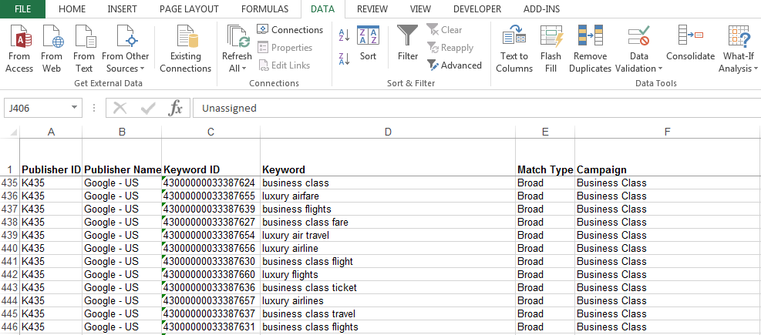
DIGITAL MARKETING
Search Advertising: Advertiser
Buying Keywords
Generic Keywords

Slide 12
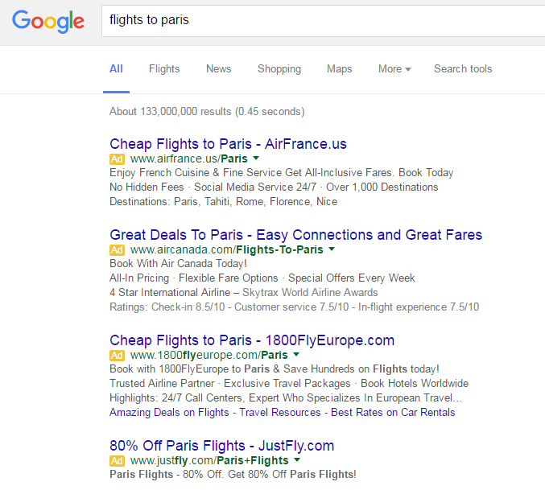
DIGITAL MARKETING
Search Advertising: Advertiser
Buying Generic Keywords
Awareness
Spillover

Slide 13
DIGITAL MARKETING
Search Advertising: The Search Engine

Slide 14
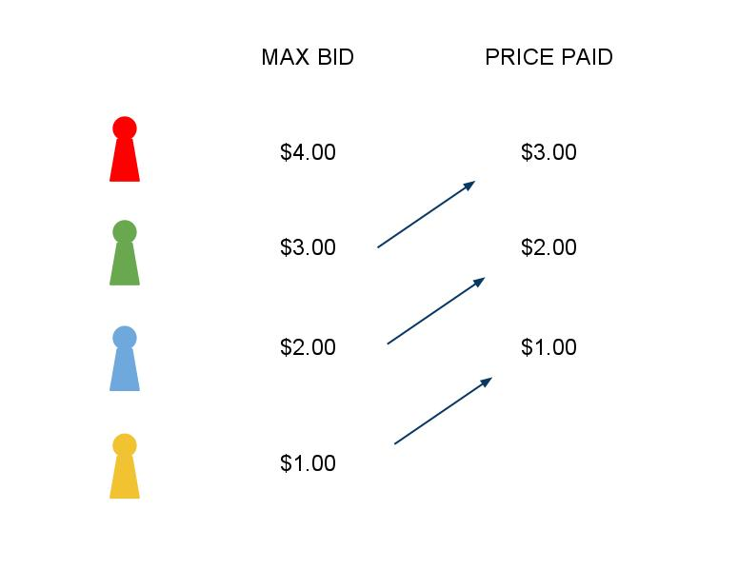
DIGITAL MARKETING
Search Advertising: The Search Engine
Buying Keywords: Second Price Auction
Cost per Click Pricing Model

Slide 15
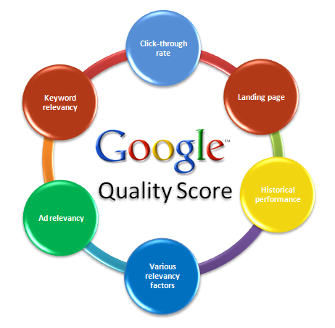
DIGITAL MARKETING
Search Advertising: The Search Engine

Slide 16
DIGITAL MARKETING
Search Advertising: Auction Example
Three Available Slots with a Reserve Price
Example 1
Example 2
Cost per Click:
(Bid x Quality Score) of next highest bidder divided by your own Quality Score

Slide 17
DIGITAL MARKETING
Search Advertising: Back to the Advertiser
Profit is (Clicks x Conversion Rate x Profit per Sale) less (Clicks x Cost per Click)
The tradeoff is between more clicks from higher position but also higher CPC
What is the relationship between position and CPC? How about position and Conversion Rate?

Slide 18
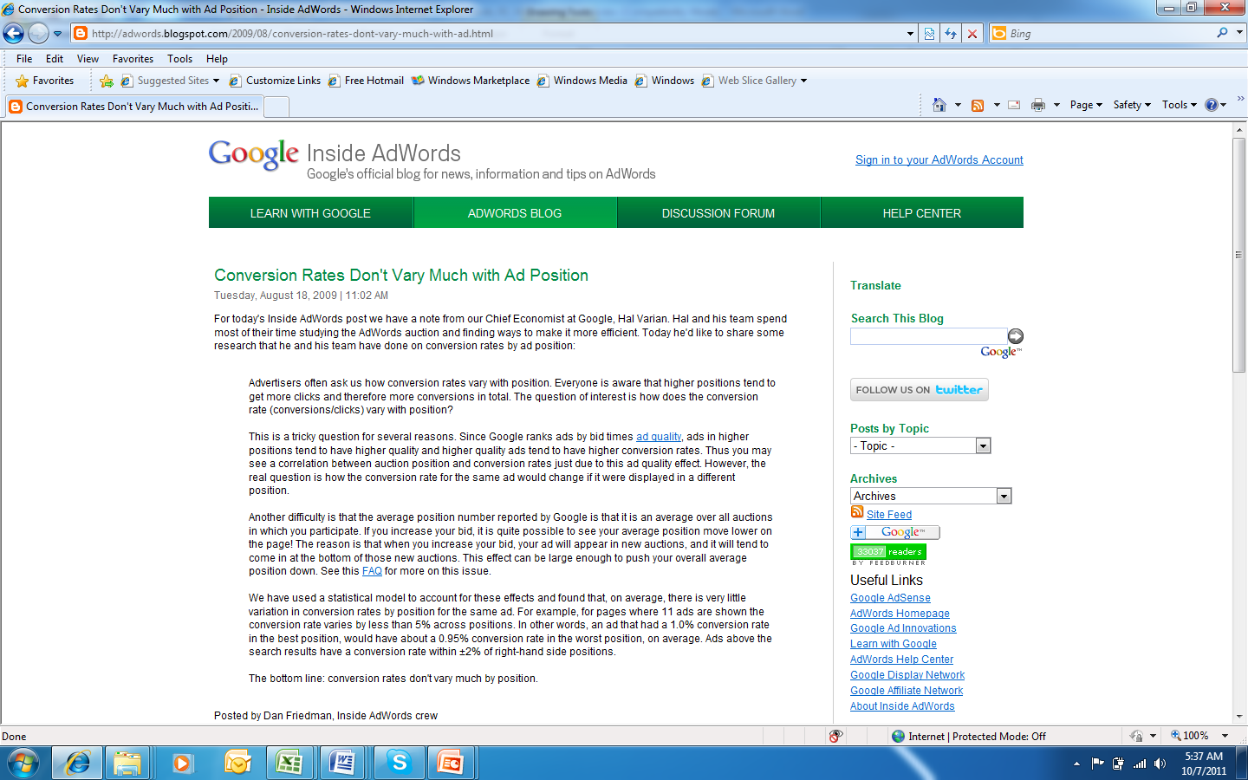
DIGITAL MARKETING

Slide 19
DIGITAL MARKETING
Search Advertising: Position and Click Thru
Air France US and Global Campaign on Google
Let’s focus on clicks, click thru rate, and position

Slide 20
DIGITAL MARKETING
Search Advertising: Position and Click Thru
Breaking Down the Data by Campaign

Slide 21
DIGITAL MARKETING
Search Advertising: Position and Click Thru
Breaking Down the Data by Campaign
Click Thru Rate (CTR) is Clicks/Impressions
Conversion Rate (CNR) is Total Bookings/Clicks

Slide 22
DIGITAL MARKETING
Search Advertising: Position and Click Thru
Breaking Down the Data by Campaign

Slide 23
DIGITAL MARKETING
Search Advertising: Position and Click Thru
Breaking Down the Data by Campaign

Slide 24
DIGITAL MARKETING
Search Advertising: Position and Click Thru

Slide 25
DIGITAL MARKETING
Search Advertising: Position and Click Thru

Slide 26
DIGITAL MARKETING
Search Advertising: Position and Click Thru
Changes in position on the low end of the scale seem to have a larger effect than changes on the high end of the scale
We can use LN (Position) to capture this effect

Slide 27
DIGITAL MARKETING
Search Advertising: Position and Click Thru

Slide 28
DIGITAL MARKETING
Search Advertising: Position and Click Thru
421,659 binary trials (click=1, no click=0)
32,666 successes
Consider the likelihood of any given trial where y=1 indicates success
Is the probability of a click given an impression

Slide 29
DIGITAL MARKETING
Search Advertising: Position and Click Thru
421,659 binary trials (click=1, no click=0)
32,666 successes
Now consider the likelihood of the 32,666 clicks given the 421,659 trials
I need a score function
I need a link function

Slide 30
DIGITAL MARKETING
Search Advertising: Position and Click Thru
421,659 binary trials (click=1, no click=0)
32,666 successes
Now consider the likelihood of the 32,666 clicks given the 421,659 trials
I need a score function
I need a link function to translate score into probability

Slide 31
DIGITAL MARKETING
Search Advertising: Position and Click Thru

Slide 32
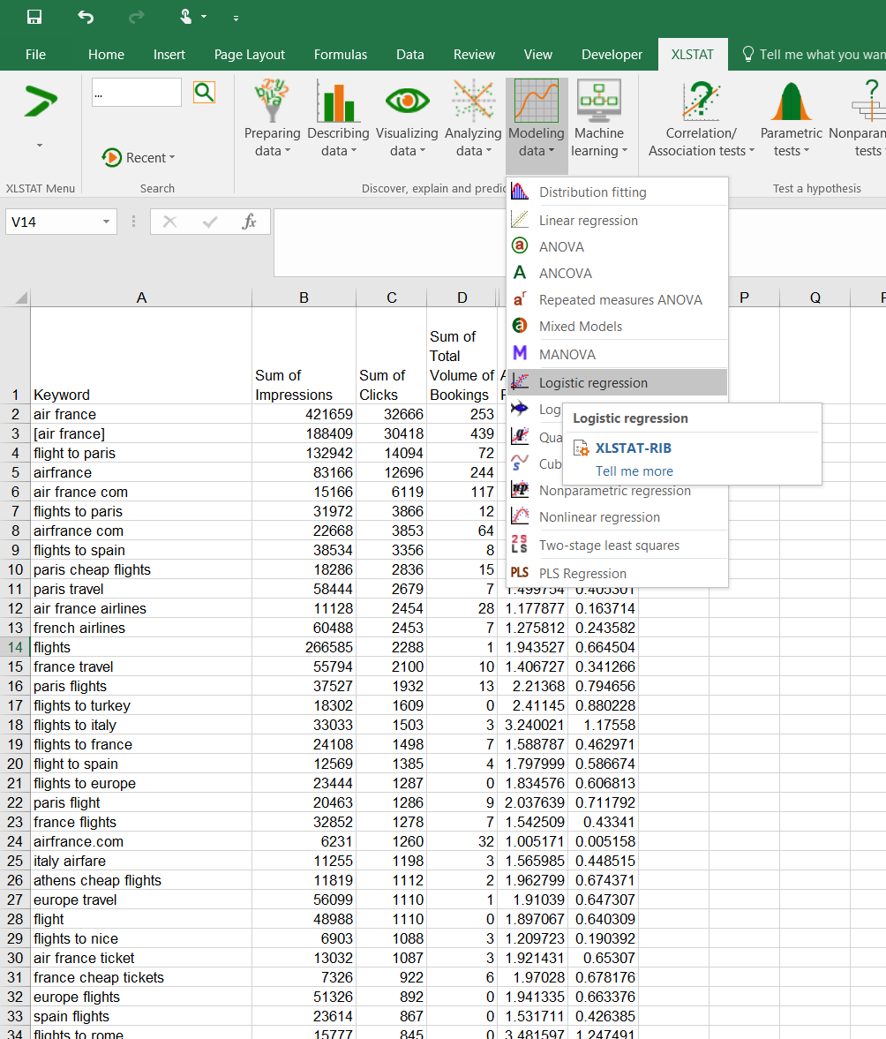
DIGITAL MARKETING
Search Advertising: Position and Click Thru

Slide 33
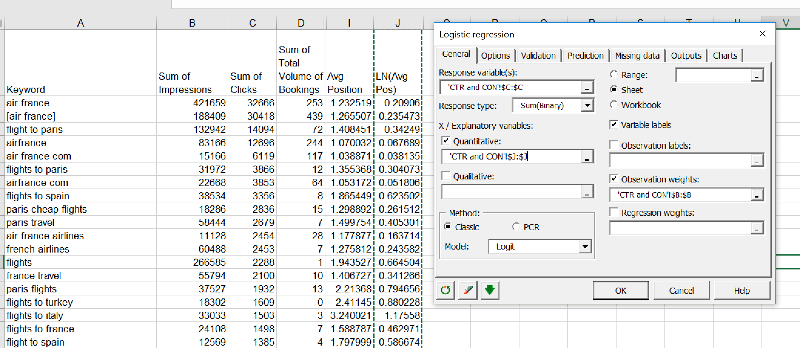
DIGITAL MARKETING
Search Advertising: Position and Click Thru
Let’s compare a score function with position vs. LN position

Slide 34
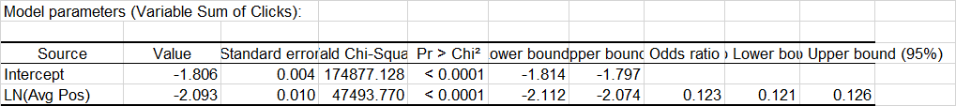
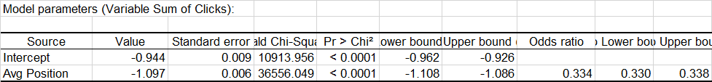
DIGITAL MARKETING
Search Advertising: Position and Click Thru
Score Function in terms of LN (Avg Pos)
Score Function in terms of (Avg Pos)
*AIC is a model of penalized model fit. Smaller is better

Slide 35
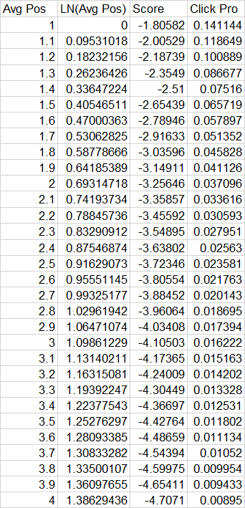
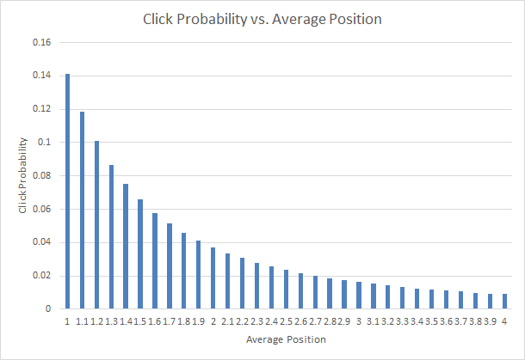
DIGITAL MARKETING
Search Advertising: Position and Click Thru

Slide 36
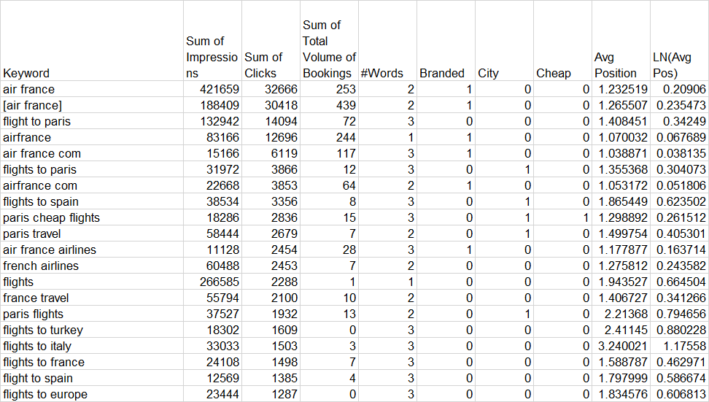
DIGITAL MARKETING
Other Features to Include in the Model

Slide 37
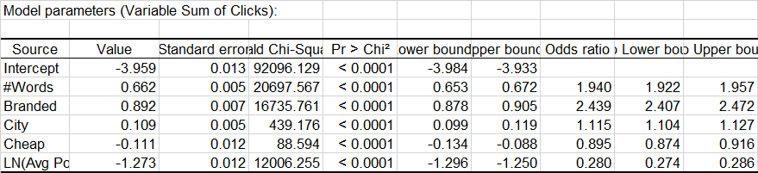
DIGITAL MARKETING
Other Features to Include in the Model

Slide 38
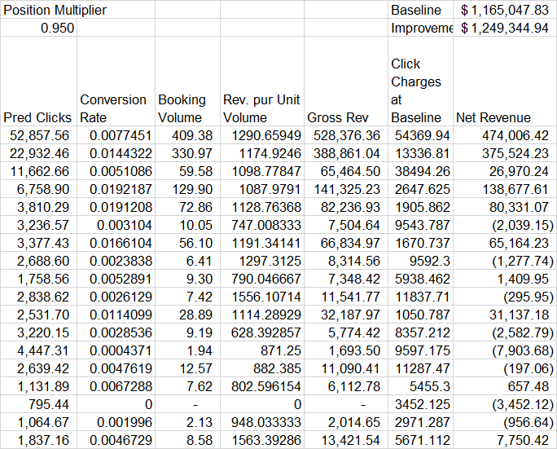
DIGITAL MARKETING
Using the Model to Assess Improved Position

Slide 39
DIGITAL MARKETING
Key Concepts from Today
Paid Search is a large component of digital advertising
Pay per click model
Position of the ad affects click probability

